Slide 1
Constraint Satisfaction Problem

Slide 2
Agenda
What is CSP?
CS task - Solution
Example of CSP
Types of constraints
Constraint Graph
Solving CSP - Backtrack Search
Real world CSP

Slide 3
What is a Constraint Satisfaction Problem?
Constraint Satisfaction Problem (or CSP) is defined by a
Set of Variables { X_{I}, X₂, . . . , X_{n} }
Set of constraints {C₁, C₂, . . ., C_{n} }
Set of domains {D₁, D₂ , … , D_{n} }
Each variable X_{i} has a nonempty domain D_{i} of possible values
• height = {short, average, tall},
• weight = {light, average, heavy}
Each constraint C_{i} involves some subset of the domain variables and specifies the allowable combinations of values for that subset.
The aim is to choose a value for each variable so that the resulting possible world satisfies the constraints

Slide 4
CSP Solution
A state of the values problem is defined by an assignment of values to some or all of the variables, {Xi = vi, Xj = vj, . . .).
An assignment that does not violate any constraints is called a consistent or legal consistent assignment.
A complete assignment is one in which every variable is mentioned, and a solution to a CSP is a complete assignment that satisfies all the constraints.
Some CSPs also require a solution that maximizes an objective function

Slide 5
Standard Search formulation of CSP
Initial state
The empty assignment { }, in which all variables are unassigned.
Successor function
A value can be assigned to any unassigned variable, provided that it does not conflict with previously assigned variables.
Goal test
The current assignment is complete.
Path cost
A constant cost (e.g., 1) for every step.

Slide 6
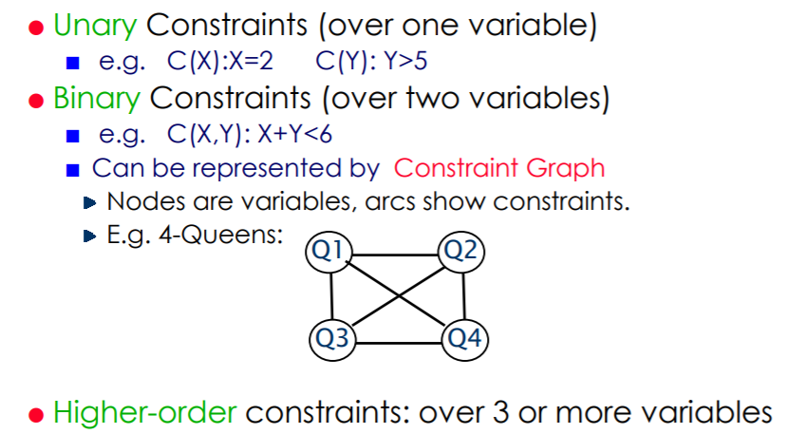
Arity of Constraints

Slide 7
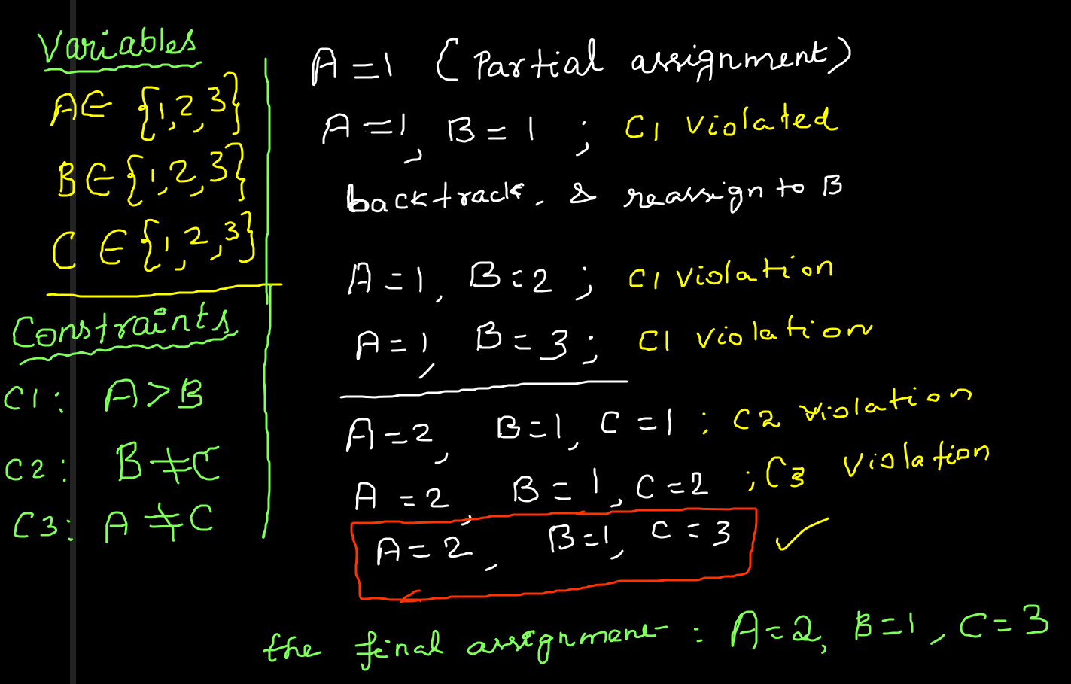
Example

Slide 8
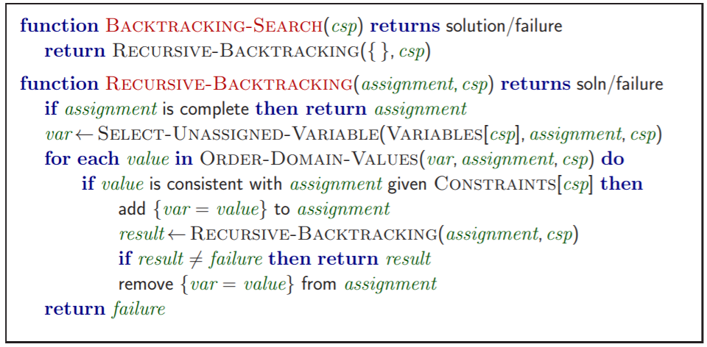
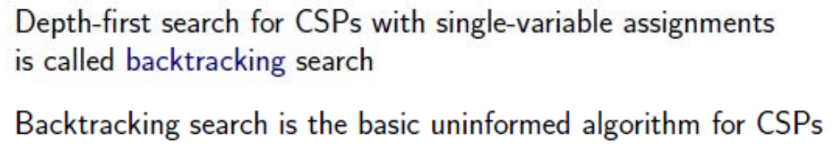
Backtracking Search

Slide 9
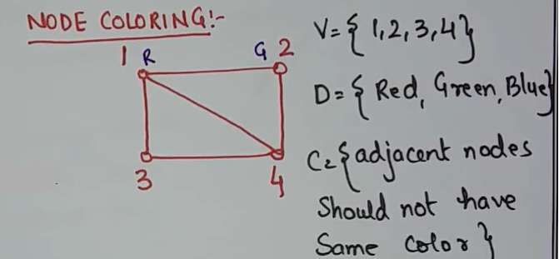
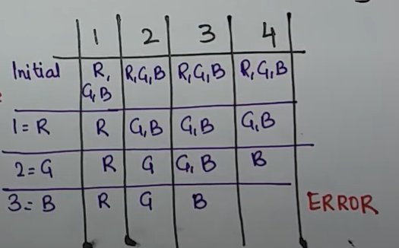

Slide 10
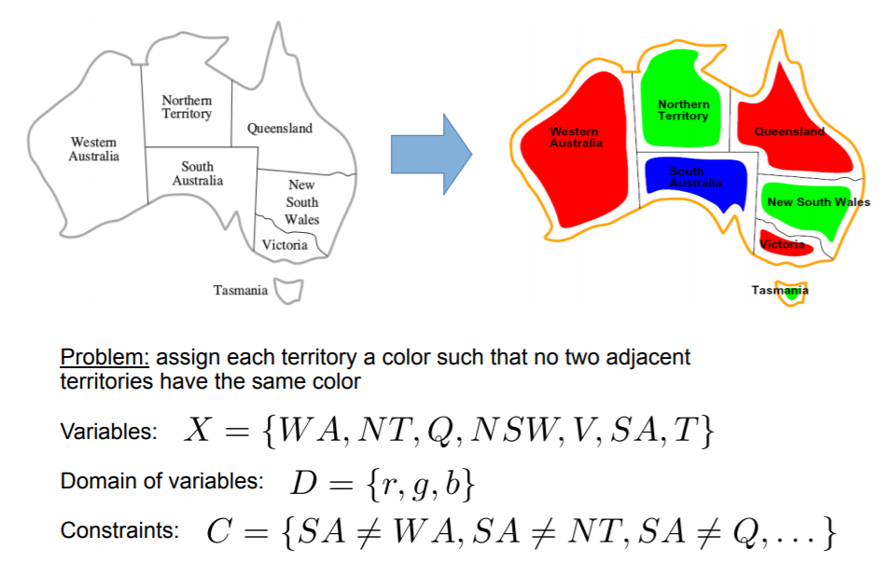
CSP Example - Map coloring

Slide 11


Slide 12
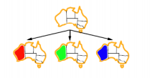

Slide 13
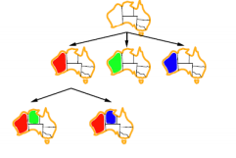

Slide 14
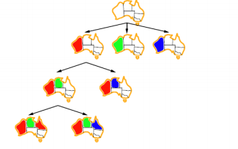

Slide 15
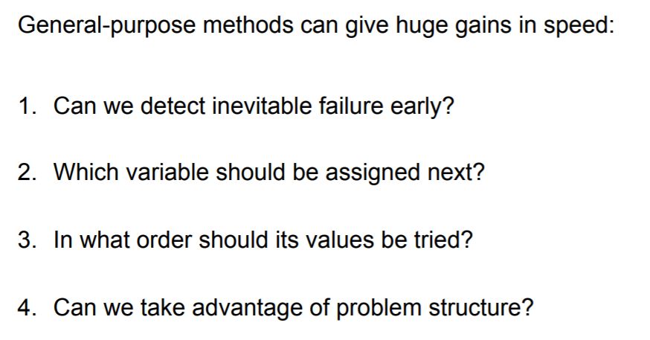
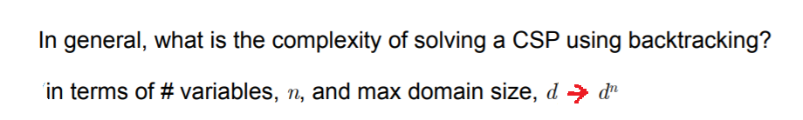
Improving Backtracking efficiency
O(d^{n})

Slide 16
There are two important ordering methods for solving CSP problems using backtracking search:
Minimum Remaining Values (MRV)
This is for ordering of variables. It tells us that it’s better to consider the variables with minimum remaining values, so it’s also known as the most constrained variables method.
Least Constraining Value (LCV)
This is for ordering of values. After we decided to consider one variable, there are many values to consider. It tells us that it’s better to consider the least constraining value firstly.

Slide 17
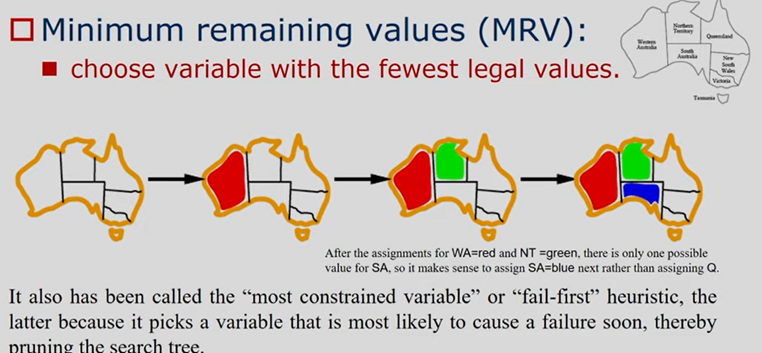
Variable and value ordering
WA
NT
SA
G
NSW
V
T

Slide 18
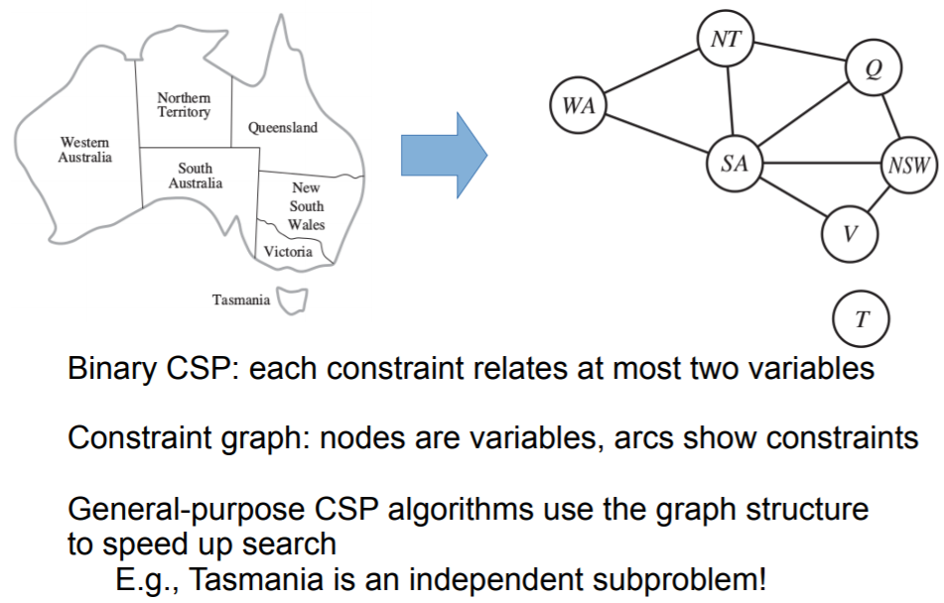
Constraint Graph

Slide 19
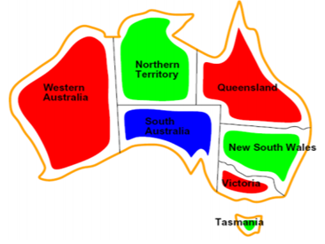

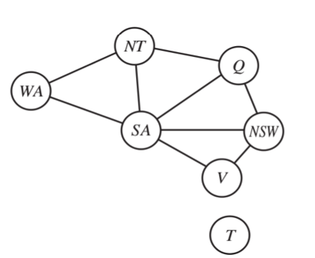


Variable and value ordering

Slide 20
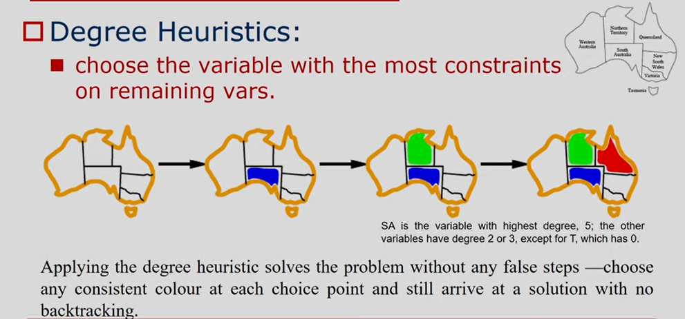
Variable and value ordering

Slide 21
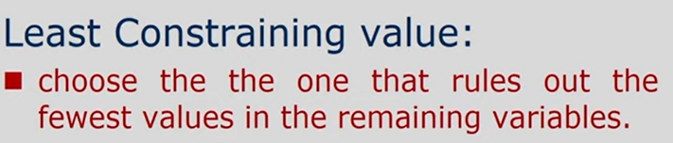
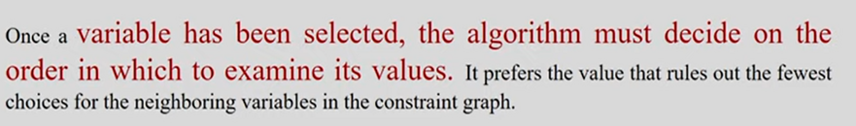
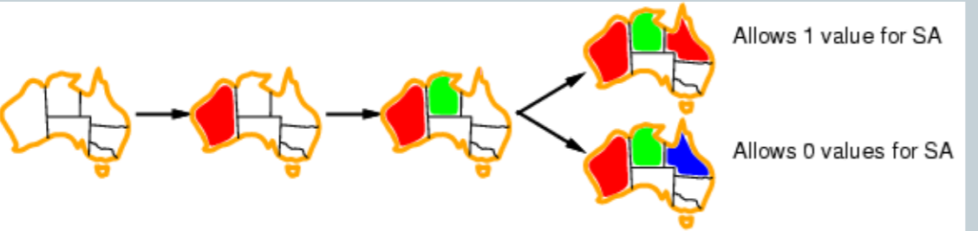
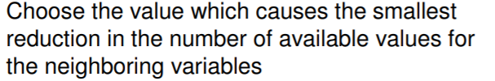
Variable and value ordering

Slide 22
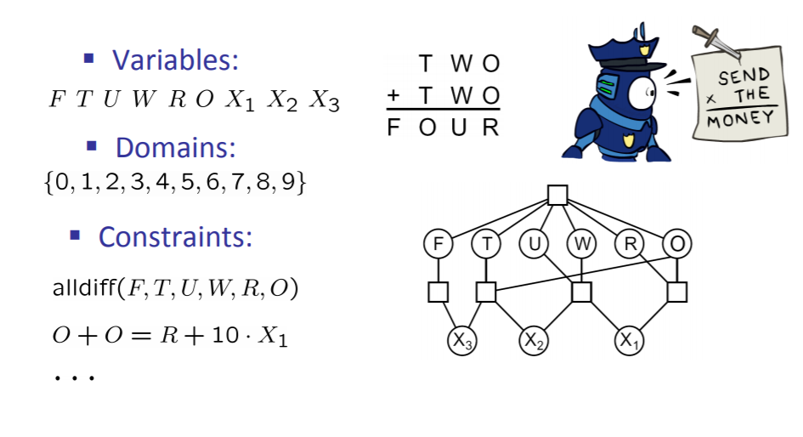
CSP Harder problem – Cryptarithmetic
Cryptarithmetic is a puzzle consisting of an arithmetic problem in which the digits have been replaced by letters of the alphabet. The goal is to decipher the letters (ie. map them back onto the digits) using the constraints provided by arithmetic and the additional constraint that no two letters can have the same numerical value

Slide 23
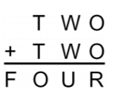
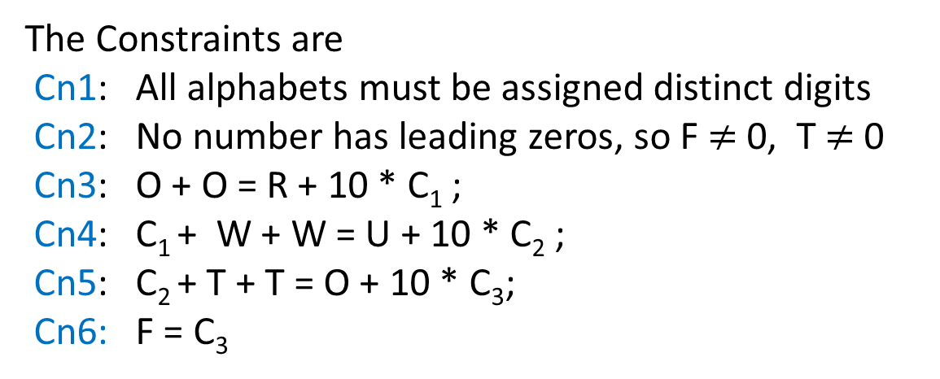
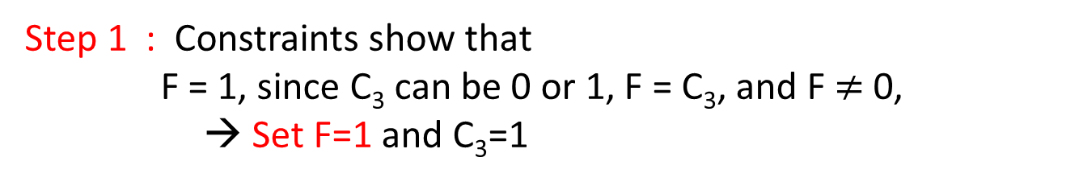
C₃ C₂ C₁
The main variables are F, O, T, U, W, R
The carriers are C₁, C₂, C₃
The Constraints are
Cn1: All alphabets must be assigned distinct digits
Cn2: No number has leading zeros, so F$≠$ 0, T$≠$ 0
Cn3: O + O = R + 10 * C₁ ;
Cn4: C₁ + W + W = U + 10 * C₂ ;
Cn5: C₂ + T + T = O + 10 * C₃;
Cn6: F = C₃
Step 1 : Constraints show that
F = 1, since C₃ can be 0 or 1, F = C₃, and F $≠$ 0,
→ Set F=1 and C₃=1

Slide 24
C₃ C₂ C₁
Step 2 : domain of T= {2,3,4, …. 9} and
domain of U, W, R, O = {0, 2, 3, 4, …..9},
T is selected (based on MRV)
Consider C₂ + T + T = O + 10 * C₃; and C₃ = 1
i.e, O = C₂ + 2T - 10
if T = {2, 3, 4 }
O = negative (invalid assignment)
if T = 5,
O = 0 → R = 0 (Cn1 - violated)
So T can be {6,7,8,9},
Set T = 6
O + O = 10 * C₁ + R ;
C₁+ W + W = U + 10 * C₂ ;
C₂ + T + T = O + 10 * C₃;
Step 3 : O = C₂ + 2T - 10 → O = C₂ + 2 ( as T = 6)
since C₂ can be 0/1, O can be 2/3
Set O = 2

Slide 25
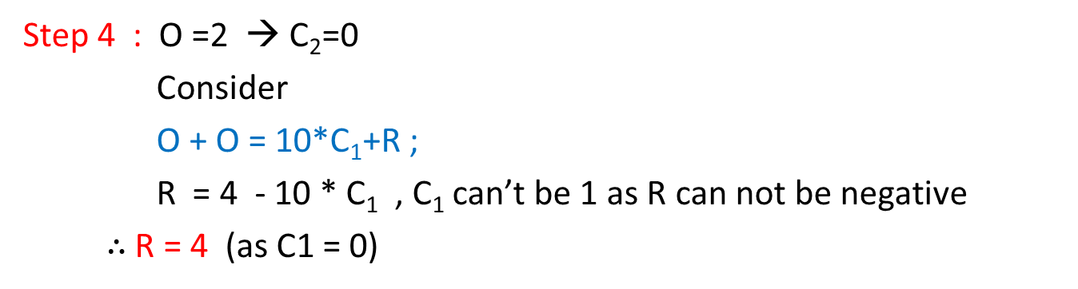
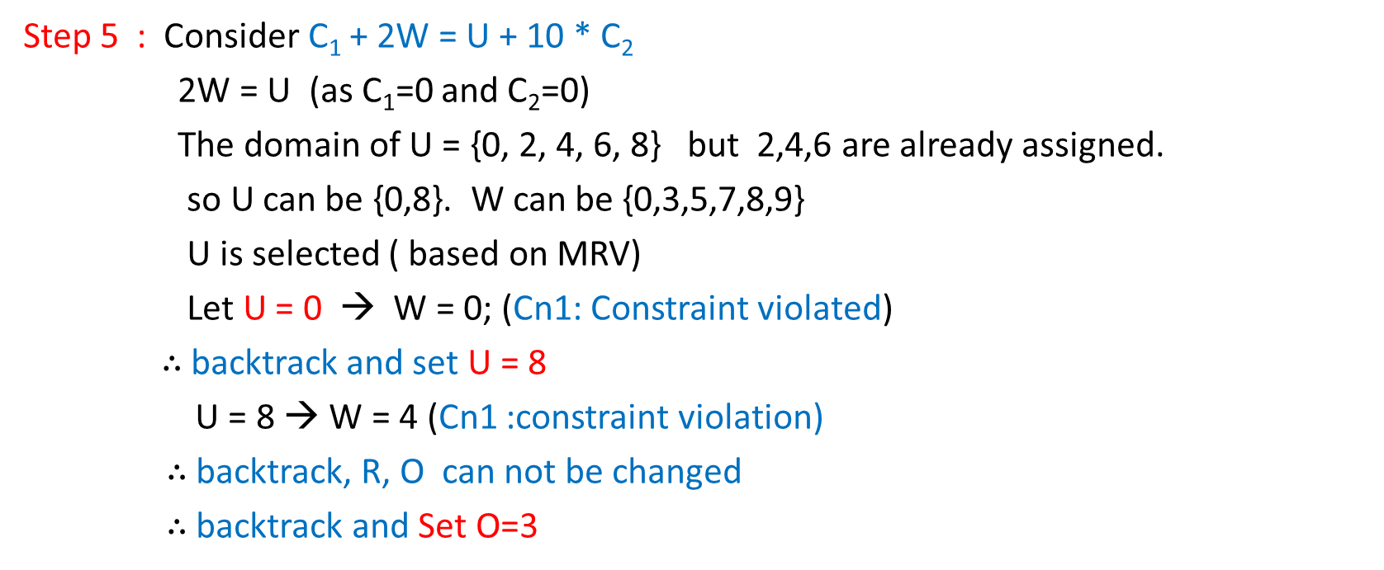
C₃ C₂ C₁
Step 4 : O =2 → C₂=0
Consider
O + O = 10*C₁+R ;
R = 4 - 10 * C₁ , C₁ can’t be 1 as R can not be negative
$∴$R = 4 (as C1 = 0)
O + O = 10 * C₁ + R ;
C₁+ W + W = U + 10 * C₂ ;
C₂ + T + T = O + 10 * C₃;
Step 5 : Consider C₁ + 2W = U + 10 * C₂
2W = U (as C₁=0 and C₂=0)
The domain of U = {0, 2, 4, 6, 8} but 2,4,6 are already assigned.
so U can be {0,8}. W can be {0,3,5,7,8,9}
U is selected ( based on MRV)
Let U = 0 → W = 0; (Cn1: Constraint violated)
$∴$backtrack and set U = 8
U = 8 → W = 4 (Cn1 :constraint violation)
$∴$backtrack, R, O can not be changed
$∴$backtrack and Set O=3

Slide 26
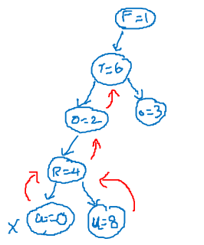
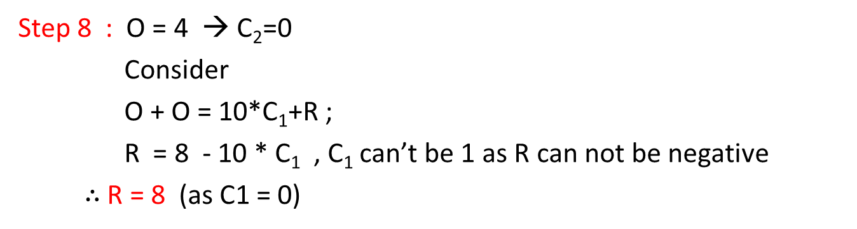
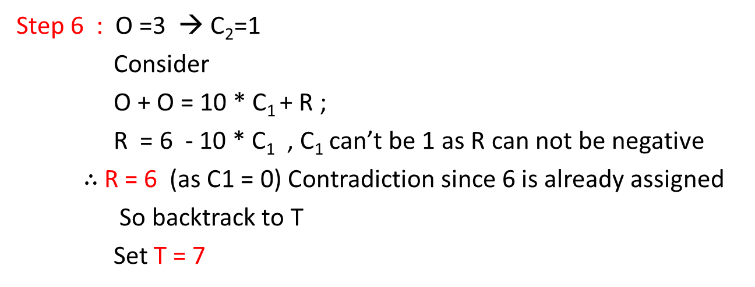
Step 6 : O =3 → C₂=1
Consider
O + O = 10 * C₁ + R ;
R = 6 - 10 * C₁ , C₁ can’t be 1 as R can not be negative
$∴$R = 6 (as C1 = 0) Contradiction since 6 is already assigned
So backtrack to T
Set T = 7
C₃ C₂ C₁
O + O = 10 * C₁ + R ;
C₁+ W + W = U + 10 * C₂ ;
C₂ + T + T = O + 10 * C₃;
Step 7 : O = C₂ + 2T - 10 → O = C₂ + 4 ( as T = 7)
since C₂ can be 0/1, O can be 4/5
Set O = 4
Step 8 : O = 4 → C₂=0
Consider
O + O = 10*C₁+R ;
R = 8 - 10 * C₁ , C₁ can’t be 1 as R can not be negative
$∴$R = 8 (as C1 = 0)

Slide 27
C₃ C₂ C₁
Step 9 : Consider C₁ + W + W = U + 10 * C₂
2W = U (as C₁=0 and C₂=0)
The domain of U = {0, 2, 6}
The domain of W is {all remaining values }
U is selected ( based on MRV)
Let U = 6 → W = 3;
O + O = 10 * C₁ + R ;
C₁+ W + W = U + 10 * C₂ ;
C₂ + T + T = O + 10 * C₃;
All the variables are assigned values, and all the constraints are satisfied
Thus, the solution to this problem is F = 1, T = 7, O = 4, R = 8, W = 3, U = 6

Slide 28
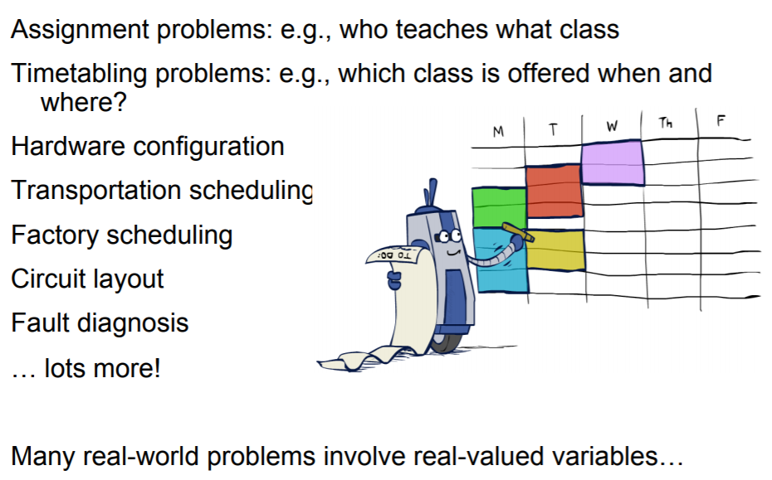
Real world CSP problems

